Slide 1

Chapter 6 Security and Reliability of Distributed Software and Systems
Lecture 25 - Part 1
Data Encryption / Decryption Service and WCF Reliability
Text Chapter 6.3
Yinong Chen

Slide 2
Roadmap of Chapter 6
General Security & Reliability Concepts (Text Section 6.1)
IIS Roles and Windows-Based Security Mechanism
Case Study: Windows-Based Security Deployment
Forms-Based Security Creating an independent security system for Web access control and resource authorization
Web.config Support to Forms-Based Security
Access Control with Self-Registration
Secure Socket Layer for Secure HTTP Connection
Data Encryption and Decryption Service
WS Reliable Messaging

Slide 3
Need for Encryption and Decryption
SSL addresses the problem during data transmission
There are always situations in which we need to encrypt and decrypt data of our own. For example,
Date stored: user IDs and passwords to be stored in the Web.config file, XML file, text file, or database;
Data transmitted over the internet without SSL
Saving sensitive data in clear text is not acceptable for an organization that cares about protecting its user privacy.

Slide 4
Encryption and Decryption Algorithms
There are many Encryption and Decryption Algorithms using the public key system: e.g., SHA-1, MD-5 used in Web.config <credential> element
Data Encryption Standard (DES) was selected by the National Bureau of Standards as an official Federal Information Processing Standard (FIPS) for the United States in 1976, and becomes an international standard.
It is based on a symmetric-key algorithm that uses a 56-bit key encryption. (MD-5 uses 128 bits.)
As the key length is short, DES is used for low-level security purpose only
[http://en.wikipedia.org/wiki/Data_Encryption_Standard].

Slide 5
Ethics Cases in Data Privacy and Encryption and Decryption Algorithms
Many encryption and decryption algorithms are of matters of national security and are classified.
Ethics Case Studies in which Encryption and Decryption Algorithms were distributed to the contractor and client companies overseas. Detail at:
http://ethics.tamu.edu/nsfcases/elen/01/ee01.htm

Slide 6
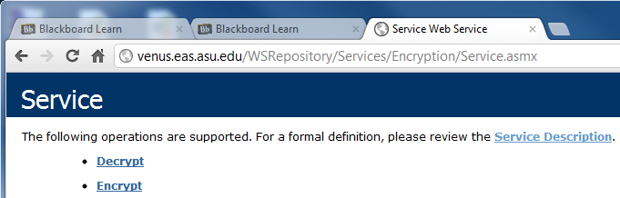
Encryption and Decryption Algorithms in FCL
.Net Framework Class Library implemented a namespace System.Security.Cryptography
It includes a number of security-related classes [http://msdn.microsoft.com/en-us/library/system.security.cryptography.aspx]
The example presented here uses the DES SymmetricAlgorithm class to create a WCF Web service with two operations:
string Encrypt(string)
string Decrypt(string)
ASU Repository:
.asmx implementation
.svc implementation

Slide 7
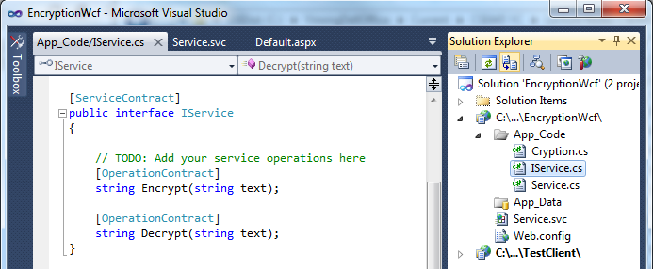
Interface Definition: Contract
File → New Web Site → WCF Service
ServiceContract and OperationContract Template are created
Enter the “Encrypt” and “Decrpyt” interface as the
[OperationContract]

Slide 8
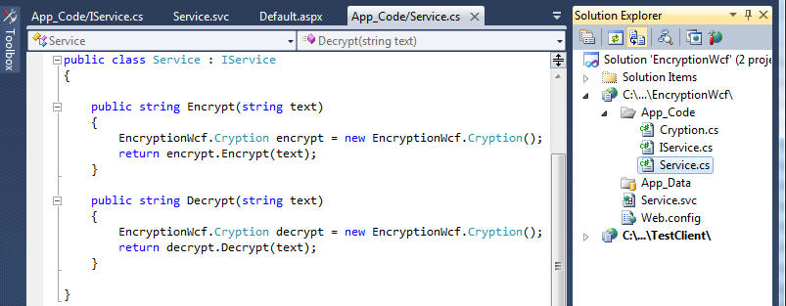
Service Implementing OperationContract

Slide 9
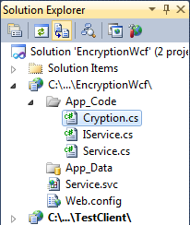
The Class Performing the Job
using System; using System.IO; using System.Text;
using System.Security.Cryptography;
namespace EncryptionWcf {
// Cryption class uses .Net Cryptography classes to perform en- and description
public sealed class Cryption {
byte[ ] seed = ASCIIEncoding.ASCII.GetBytes("cse44598"); // A seed from a binary array for encryption
public string Encrypt(string plainString) { // encryption using DES
if (String.IsNullOrEmpty(plainString)) {
throw new ArgumentNullException("The input cannot be empty or null!");
}
SymmetricAlgorithm saProvider = DES.Create();
MemoryStream mStream = new MemoryStream();
CryptoStream cStream = new CryptoStream(mStream,
saProvider.CreateEncryptor(seed, seed), CryptoStreamMode.Write);
StreamWriter sWriter = new StreamWriter(cStream);
// Continued next page

Slide 10
The Class Performing the Job (Contd.)
sWriter.Write(plainString);
sWriter.Flush(); // Buffer flush is necessary when switching writing modes
cStream.FlushFinalBlock();
return Convert.ToBase64String(mStream.GetBuffer(), 0, (int)mStream.Length);
}
public string Decrypt(string encryptedString) { // decryption using DES
if (String.IsNullOrEmpty(encryptedString)) {
throw new ArgumentNullException("The string cannot be empty or null!");
}
SymmetricAlgorithm saProvider = DES.Create();
MemoryStream memStream = new MemoryStream
(Convert.FromBase64String(encryptedString));
CryptoStream cStream = new CryptoStream(memStream,
saProvider.CreateDecryptor(seed, seed), CryptoStreamMode.Read);
StreamReader reader = new StreamReader(cStream);
return reader.ReadLine();
} } }

Slide 11
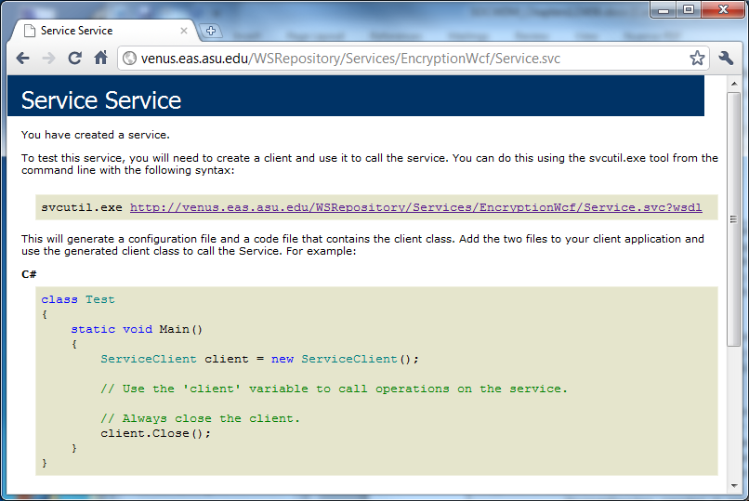
Encryption and Decryption Service Deployed
http://venus.eas.asu.edu/WSRepository/Services/EncryptionWcf/Service.svc
Can we use this service to replace SSL to save the certification cost?

Slide 12
WCF Clients
WCF is used for creating services only;
WCF services can be invoked by any service clients: Console application, ASP .Net application, Workflow application, Silverlight application, etc.
Clients connect to the WCF services through proxy:
Proxy connects to the endpoints
Proxy is generated from service contracts
Client needs to specify what endpoint to invoke for its operations
Use “Add Service Reference” to add references to WCF services, instead of using “Add Web Reference”

Slide 13
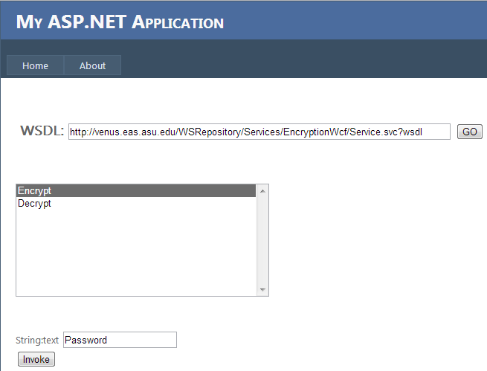
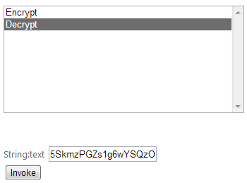
Test the Encryption and Decryption Service
5SkmzPGZs1g6wYSQzOFFfQ==
Password

Slide 14
Endpoints: A-B-C Created in the Client
<configuration>
<system.serviceModel>
<bindings>
<basicHttpBinding>
<binding name="BasicHttpBinding_IService“ >
<security mode="None">
<transport clientCredentialType="None" proxyCredentialType="None“ realm="" />
<message clientCredentialType="UserName" algorithmSuite="Default" />
</security>
</binding>
</basicHttpBinding>
</bindings>
<client>
<endpoint
address="http://venus.eas.asu.edu/WSRepository/Services/EncryptionWcf/Service.svc"
binding="basicHttpBinding" bindingConfiguration="BasicHttpBinding_IService"
contract="EncryptService.IService" name="BasicHttpBinding_IService"
</endpoint>
</client>
</system.serviceModel>
</configuration>

Slide 15
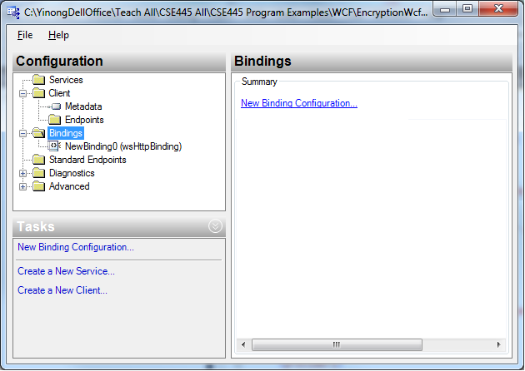
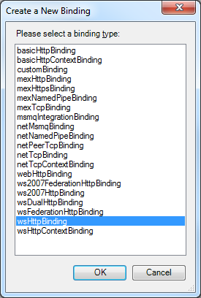
Adding a Different Binding Protocol
In VS Menu: Tools → WCF Service Configuration Editor
Browse to the application and select the Web.Config file

Slide 16
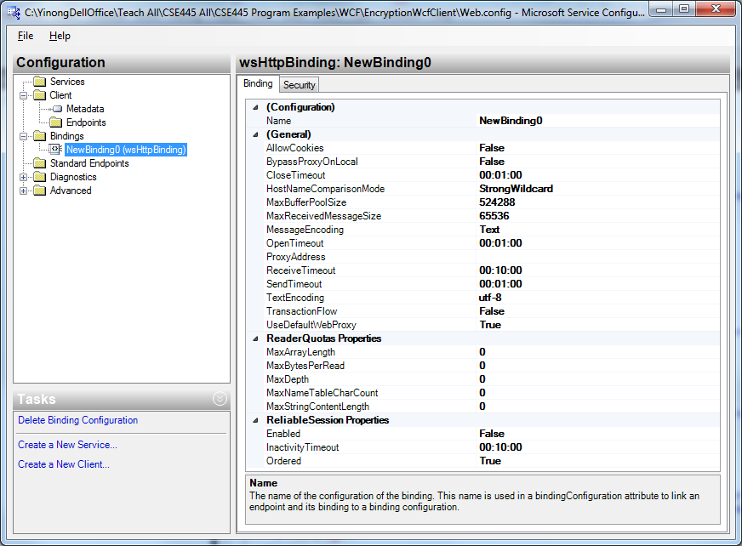
Editing the Configuration File

Slide 17

Reliable Messaging
(Text Section 6.4)

Slide 18
SOA Reliability Issues
"Web services are not yet widely used because of security concerns. But there's an even bigger roadblock waiting just down the road -- it's called trust. The big issue is "Will the service work correctly every time when I need it?" As yet few are thinking about the issues of testing and certification, we suggest that testing and certification of Web services is not business as usual and that new solutions are needed to provide assurance that services can really be trusted." -- By CBDi Forum, at <http://searchwebservices.techtarget.com/>, 11 Jul 2002.

Slide 19
Web Service Testing, as Discussed in Chapter 3
Software testing often takes more effort than software development, and thus there are huge demands on software testing professionals;
Software black-box testing vs. white-box testing
How do we do Web service testing?
Source code not available: Black-box Testing;
WSDL file is available: WSDL analysis to obtain URL, operations, input and output types;
Generate test cases: based on the input types;
Dynamically invoke the Web service;
Analyze the return values

Slide 20
WS-RM: ReliableMessaging and Others
WS-ReliableMessaging (WS-RM) deals with faults at the message level, including
Lost messages
Duplicated messages
Messages received out of order
Suitable in the scenarios where both parties are online
Message Queuing, e.g., MSMQ:
Ensure reliable communication between the sender and the receiver.
Suitable in the scenarios where the receiver may be offline
Transactions for enterprise application

Slide 21
WS-ReliableMessaging (WS-RM)
WS-RM Adoption Among Leading Vendors (Data 2007)
Company/Platform WS-RM Support
Microsoft WCF Yes
IBM, ETTK—AlphaWorks Yes
Oracle SOA Suite Yes
BEA, WebLogic 9.0 Yes
Cape Clear Yes
Systinet Yes
Blue Titan Yes
Apache Axis 1.3 Sandesha Yes
Sonic In Development
Tibco In Development

Slide 22
WS-ReliableMessaging Features
WS-RM specification defines the following reliability features
Guaranteed message delivery, or At-Least-Once delivery semantics
Guaranteed message duplicate elimination, or At-Most-Once delivery semantics
Guaranteed message delivery and duplicate elimination, or Exactly-Once delivery semantics
Guaranteed message ordering for delivery within a group of messages

Slide 23
WS-ReliableMessaging Protocol
Endpoint B
Endpoint A
Establish Protocol Preconditions
It includes policy exchange, endpoint resolution, and establishing trust;
RM Source requests creation of a new Sequence;
RM Destination creates a new Sequence and returns its unique Identifier (ID = ABC);
RM Source transmits messages in the Sequence with MessageNumber 1.
RM Source transmits the 2nd message with MessageNumber 2, and is lost in transit;
RM Source transmits the 3rd message with MessageNumber 3,
The 1st message is acknowledged by destination;
The 3rd message is acknowledged by destination;
No acknowledgement in given time;
RM Source retransmits the 2nd message with MessageNumber 2;
The 2nd message is acknowledged by destination;
RM Source terminates the sequence ABC.
RM Source CreatesSequence
Destination CreateSequenceResponse
Sequence (ID = ABC, #1)
Sequence (ID = ABC, #2)
Sequence (ID = ABC, #3)
SequenceAcknowledgement (Identifier =1...3)
SequenceAcknowledgement (Identifier =3...3)
Sequence (ID = ABC, #2)
SequenceAcknowledgement (Identifier =2...3)
TerminateSequence (ID = ABC)

Slide 24
The Message for Creating a Sequence
<soap:body>
<wsrm:CreateSequence ...>
<wsrm:AcksTo> wsa:EndpointReferenceType </wsrm:AcksTo>
<wsrm:Expires ...> xs:duration </wsrm:Expires> ?
<wsrm:Offer ...>
<wsrm:Identifier ...> xs: http://cse445.com/ </wsrm:Identifier>
<wsrm:Endpoint> wsa:EndpointReferenceType </wsrm:Endpoint>
<wsrm:Expires ...> xs:duration </wsrm:Expires> ?
<wsrm:IncompleteSequenceBehavior>
wsrm:IncompleteSequenceBehaviorType
</wsrm:IncompleteSequenceBehavior> ?
</wsrm:Offer> ?
</wsrm:CreateSequence>
<soap:body>

Slide 25
For Message Number and Acknowledge
<soap:header>
<wsrm:sequence>
<wsrm:identifier>http://cse445.com/RM/ABC</wsrm:identifier>
<wsrm:messagenumber>1</wsrm:messagenumber>
</wsrm:sequence>
</soap:header>
<soap:header>
<wsrm:sequenceacknowledgement>
<wsrm:identifier>http://cse445.com/RM/ABC</wsrm:identifier>
<wsrm:acknowledgementrange lower="1" upper="1" />
<wsrm:acknowledgementrange lower="3" upper="3" />
</wsrm:sequenceacknowledgement>
</soap:header>

Slide 26
Client Initiated Transactions
WCF transactions are built on top of System.Transactions + WS-*
Initiate a transaction in client code
Transaction is flowed to all services called that support transactions
using (TransactionScope scope = new TransactionScope())
{
// Call Service1 – transaction flowed to service1
// Call Service2 – transaction flowed to service2
scope.Complete();
} // All commit or all rollback

Slide 27
Code with More Detail
using (TransactionScope transScope = new TransactionScope()) {
// Create an connection channel
using (SqlConnection connection1 = new SqlConnection(connectString1)) {
connection1.Open(); // Opening connection1 to prepare withdrawal
connection1.BeginTransaction(IsolationLevel.Serializable);
// The connection will be listed in the TransactionScope
// Create another connection channel
using (SqlConnection connection2 = new SqlConnection(connectString2)) {
connection2.Open(); // Opening connection2 to prepare deposit
connection2.BeginTransaction(IsolationLevel.Serializable);
// The connection will be listed in the TransactionScope
}
}
// The actual method that commits the transaction.
transScope.Complete();
}

Slide 28
Enabling Transactions
Transactions do not flow by default
Requirements:
Enclose service calls in transaction scope on client
transactionFlow = true on binding
[TransactionFlow] attribute on service contract methods
Optional – specify transaction scoping options
OperationBehavior attribute on service methods
TransactionFlowRequired = true
TransactionAutoComplete = true
Enable WS-Atomic Transactions on DTC (Distributed Transaction Coordinator):
xws_reg –wsat + at command line

Slide 29
Summary of Chapter 6
General Security & Reliability Concepts (Text Section 6.1)
IIS Roles and Windows-Based Security Mechanism
Forms-Based Security Creating an independent security system for Web access control and resource authorization
Web.config Support to Forms-Based Security
Access Control with Self-Registration
Secure Socket Layer for Secure HTTP Connection
Data Encryption and Decryption Service
Reliability: Reliable messaging and transaction

